Slide 1




LAPLACE DOMAIN: INTRODUCTION
Laplace domain or the S-domain is a way to transform systems into a linear form so we can easily solve them!
In practice, it allows us to easily solve problems such as differential equations.
It represents systems in a compact transfer function form.
$$F(s)$$
TRANSFER FUNCTION
$$X(s)$$
$$INPUT$$
$$OUTPUT$$
http://www.maplesoft.com/applications/view.aspx?SID=3926&view=html

Slide 2
Laplace domain or the S-domain is a way to transform systems into a linear form so we can easily solve them!
The function f(t), which is a function of time, is transformed to a function F(s). The function F(s) is a function of the Laplace variable, "s." We call this a Laplace domain function. So the Laplace Transform takes a time domain function, f(t), and converts it into a Laplace domain function, F(s).
We use a lowercase letter for the function in the time domain, and un uppercase letter in the Laplace domain.
We say that F(s) is the Laplace Transform of f(t),
LAPLACE DOMAIN: INTRODUCTION
The function f(t), which is a function of time, is transformed to a function F(s).
The function F(s) is a function of the Laplace variable, "s." We call this a Laplace domain function.
Laplace Transform takes a time domain function, f(t), and converts it into a Laplace domain function, F(s).
We say that F(s) is the Laplace Transform of f(t)
f(t) is the inverse Laplace Transform of F(s)
http://www.maplesoft.com/applications/view.aspx?SID=3926&view=html

Slide 3
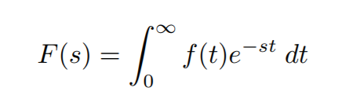
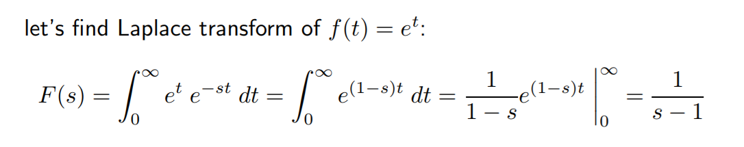
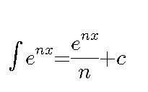
LAPLACE DOMAIN EVALUATION: EXAMPLE #1
The Laplace transform of a signal (function) f is defined by:
Remember!
https://web.stanford.edu/~boyd/ee102/laplace.pdf

Slide 4
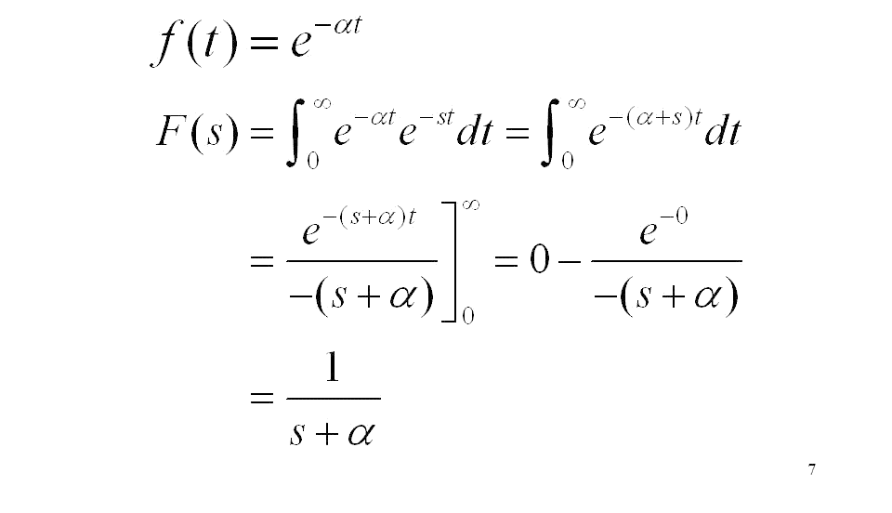
LAPLACE DOMAIN EVALUATION: EXAMPLE #2
http://slideplayer.com/slide/6636277/

Slide 5
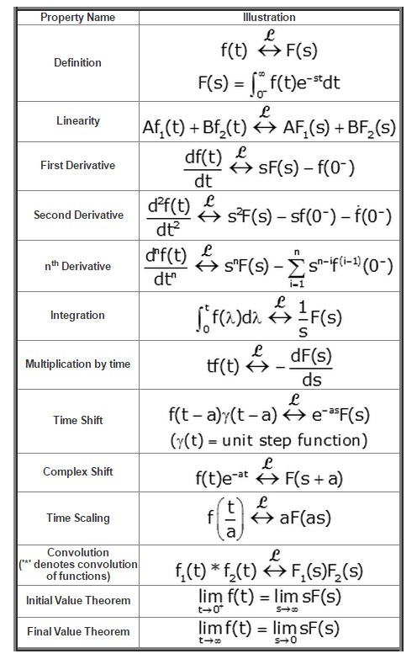
LAPLACE DOMAIN: TABLE
http://ddgrafx.com/table-of-laplace-transforms-photos/27624/

Slide 6
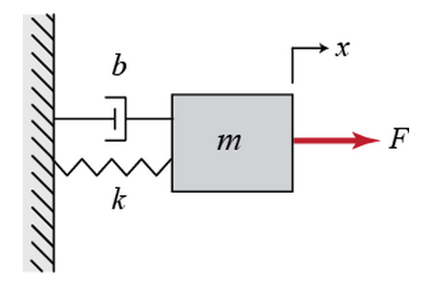
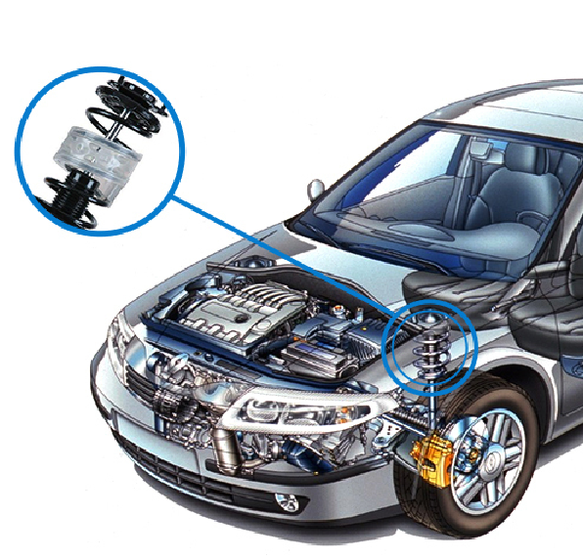
LAPLACE DOMAIN: PRACTICAL EXAMPLE
1. LET’S UNDERSTAND THE SYSTEM FIRST
SPRING & DAMPER
NO DAMPER
http://www.maplesoft.com/applications/view.aspx?SID=3926&view=html

Slide 7

LAPLACE DOMAIN: PRACTICAL EXAMPLE
2. LET’S DEVELOP A MATHEMATICAL MODEL
$M\ddot{x}=F−b\dot{x}−kx$
$Ms^{2}X\left(s\right)=F\left(s\right)−bsX\left(s\right)−kX\left(s\right)$
$$\frac{X(s)}{F(s)}=\frac{1}{Ms^{2}+bs+k}$$
Assume M = 1 Kg, b = 10 Ns/m, k = 20 N/m
$$\frac{X(s)}{F(s)}=\frac{1}{s^{s}+10s+20}$$
$$F(s)$$
TRANSFER FUNCTION
$$X(s)$$
$$INPUT$$
$$OUTPUT$$
TRANSFER FUNCTION
http://ctms.engin.umich.edu/CTMS/index.php?example=Introduction&section=ControlPID

